Slide 1

JVM Tuning for Spark

Slide 2


Greeting
Andrei Sadovskii
Big Data developer
andrei_sadovkii@epam.com
https://github.com/minikill

Slide 3
What is spark
ETC…

Slide 4

Agenda
Memory
GC
CMS
G1
Shenandoah
ZGC
JIT
Spark Test

Slide 5
STAck

Slide 6
Memory - stack
Size

Slide 7
Memory - stack
-Xss
Linux/x86 (64-bit): 1 MB
macOS (64-bit): 1 MB
Oracle Solaris (64-bit): 1 MB
On Windows, the JVM uses the system-wide stack size

Slide 8
Heap

Slide 9
Memory - heap
Parameter | Value
MinHeapFreeRatio | 40
MaxHeapFreeRatio | 70
-Xms | 100m
-Xmx | 250m
MinHeapFreeRatio
MaxHeapFreeRatio
-Xms
-Xmx
NewRatio
NewSize
NewMaxSize
SurvivorRatio

Slide 10
Compressed oops

Slide 11
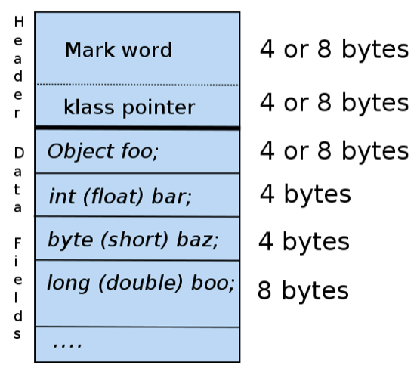
Compressed oops
The following oops in the heap will be compressed:
the klass field of every object
every oop instance field
every element of an oop array (objArray)

Slide 12
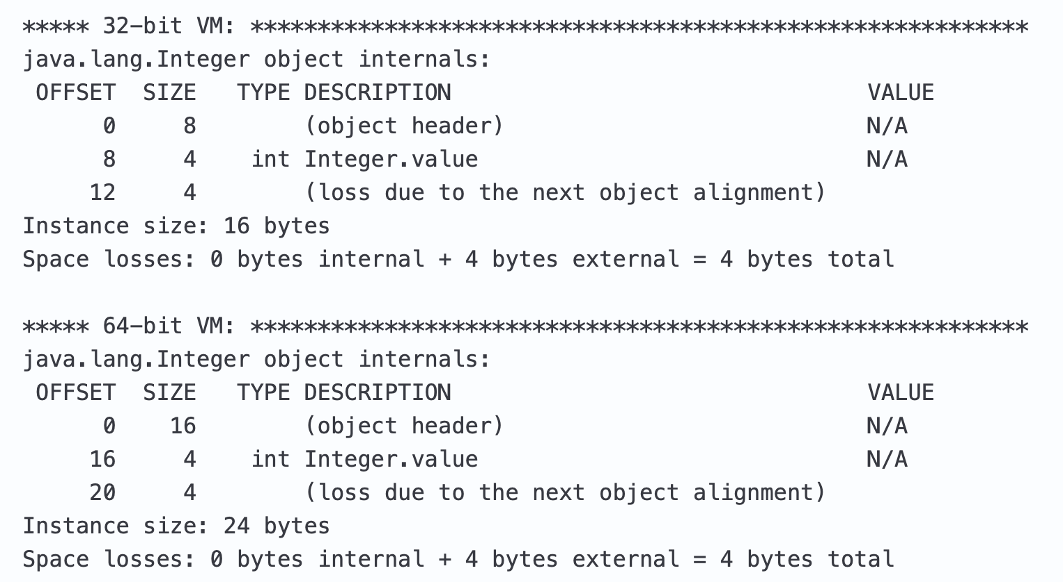
Compressed oops
= 8 * 2
= 8 * 3

Slide 13
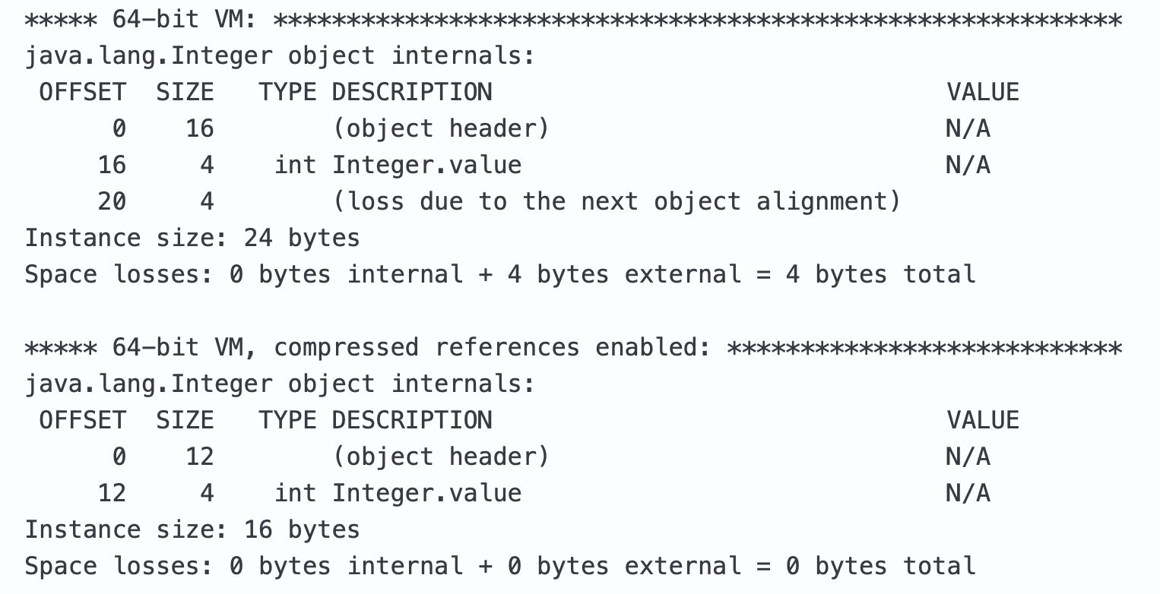
Compressed oops

Slide 14
Compressed oops
+UseCompressedOops

Slide 15
Strings

Slide 16
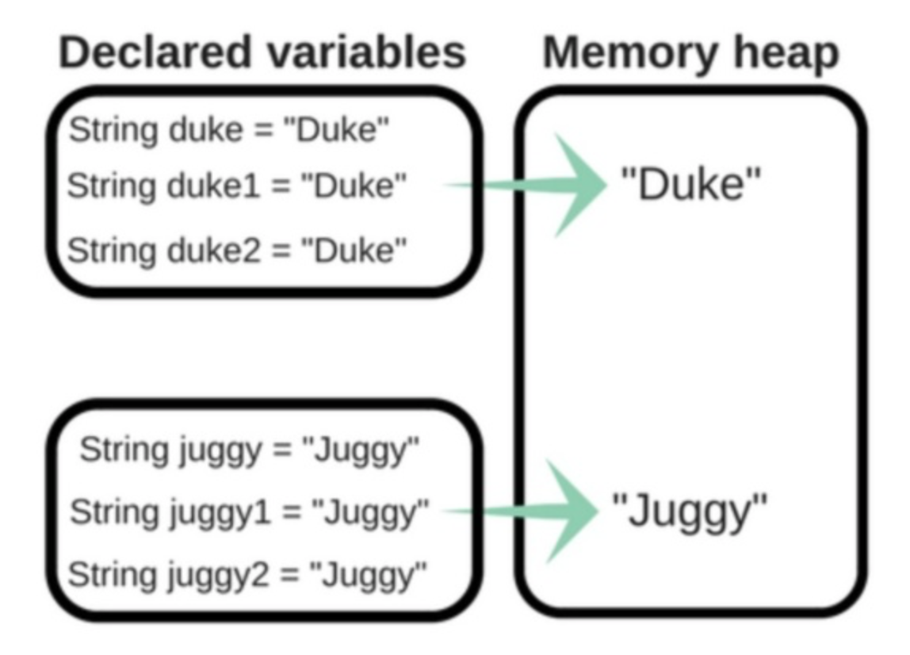
String interning
StringTableSize

Slide 17
strings deduplication
Before
After
JEP 192: String Deduplication in G1

Slide 18
strings deduplication
Works only with G1 GC algorithm
Impact on GC pause times
Works only on long lived objects
UseStringDeduplication
StringDeduplicationAgeThreshold
JEP 192: String Deduplication in G1

Slide 19
Compact strings
JEP 254: Compact Strings

Slide 20
compact Strings
java version "1.8.0_121"
Java(TM) SE Runtime Environment (build 1.8.0_121-b13)
Java HotSpot(TM) 64-Bit Server VM (build 25.121-b13, mixed mode)
$java -cp lib\jol-cli-0.9-full.jar;. test.JOLSample
java.lang.String@4554617cd footprint:
COUNT AVG SUM DESCRIPTION
1 432 432 [C
1 24 24 java.lang.String
2 456 (total)
...
$java -version
java version "9"
Java(TM) SE Runtime Environment (build 9+181)
Java HotSpot(TM) 64-Bit Server VM (build 9+181, mixed mode)
$java -cp lib\jol-cli-0.9-full.jar;. test.JOLSample
java.lang.String@73035e27d footprint:
COUNT AVG SUM DESCRIPTION
1 224 224 [B
1 24 24 java.lang.String
2 248 (total)
char[]
byte[]
JEP 254: Compact Strings

Slide 21
compact Strings
CompactStrings

Slide 22
Metaspace

Slide 23
Memory - Metaspace
MaxMetaspaceSize
JEP 122: Remove the Permanent Generation

Slide 24
Elastic Metaspace

Slide 25
Memory - metaspace
MetaspaceReclaimPolicy (balanced|aggressive|none)
balanced | Footprint improvements. Negative effects minimised
aggressive | Increased memory-reclamation rate at the cost of fragmentation
none | Disables memory reclamation altogether
JEP 387: Elastic Metaspace

Slide 26
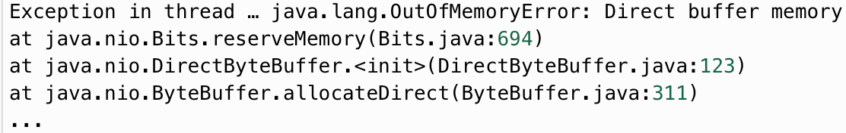
Memory - off-heap
Reduce the number of I/O threads
MaxDirectMemorySize
Limit the per-thread DirectByteBuffer size
Djdk.nio.maxCachedBufferSize

Slide 27
Garbage collection

Slide 28

Garbage collection
CMS
available for Spark
G1
Zgc
Shenandoah

Slide 29
Garbage collection - CMS
Concurrent Mark Sweep
For multicore machines
For STW sensitive apps
UseConcMarkSweepGC
CMSInitiatingOccupancyFraction

Slide 30
Garbage collection - g1
Pros:
Accurate pauses prediction
Lower STW due to multithreading
Cons:
Humongous region
High resource consuming
Relatively low throughput
MaxGCPauseMillis
ParallelGCThreads
G1HeapRegionSize
ConcGCThreads
JEP 248: Make G1 the Default Garbage Collector

Slide 31
Garbage collection - zgc & Shenandoah
ZGC Features:
Sub-millisecond max pause times
Pause times do not increase with the heap, live-set or root-set size
Handle heaps ranging from a 8MB to 16TB in size
-XX:+UnlockExperimentalVMOptions -XX:+UseZGC
Shenandoah Features:
Concurrent evacuation
Reduces GC pause times
Pause times with Shenandoah are independent of heap size
-XX:+UnlockExperimentalVMOptions -XX:+UseShenandoahGC
JEP 333: ZGC: A Scalable Low-Latency Garbage Collector
JEP 379: Shenandoah: A Low-Pause-Time Garbage Collector

Slide 32
jit

Slide 33
Jit
C1 - fast
C2 - optimized

Slide 34
Jit
5 compilation levels:
0 - interpreted code
Sequence | Description
0-3-4 | Most common case
0-2-3-4 | Queue 4 level overflowed
0-2-4 | Queue 3 level overflowed
0-3-1 | For simple methods
0-4 | Tiered compilation disabled
1 - C1 with full optimization (no profiling)
2 - C1 with invocation and backedge counters
3 - C1 with full profiling
TieredCompilation
4 - C2
TieredStopAtLevel

Slide 35
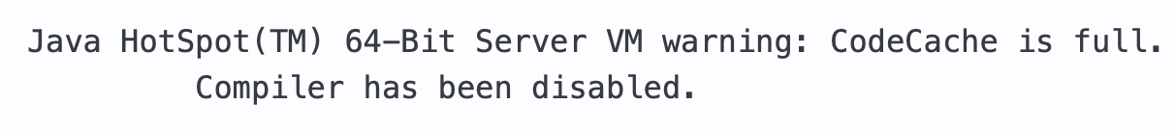
Jit - Code cache
InitialCodeCacheSize
ReservedCodeCacheSize
Default initial size = 2496 KB
Default max size = 48 MB (if tired compilation disabled)
Default max size = 240 MB (if tired compilation enabled)
JEP 197: Segmented Code Cache

Slide 36
Jit - code cache segments
non-method
non-profiled
profiled-code
NonNMethodCodeHeapSize
NonProfiledCodeHeapSize
ProfiledCodeHeapSize

Slide 37
Jit - compiler thresholds
The main triggers for compilation:
method invocation counter
loop iterations counter
Tier3InvocationThreshold
Tier4InvocationThreshold
Reminder:
Tier 3 - C1 with full profiling
Tier 4 - C2

Slide 38
Jit
Compiler optimizations:
inlining
escape-analysis
loop unrolling
monomorphic dispatch
intrinsic-methods
….

Slide 39
Jit inlining
Inlining reduced overhead on:
method parameters preparation
StackFrame creation
returning value
Method #1
JIT
Inlined method
Method #2

Slide 40
Lets spark it

Slide 41
Spark test
Word count application
Batch mode
Stream mode

Slide 42
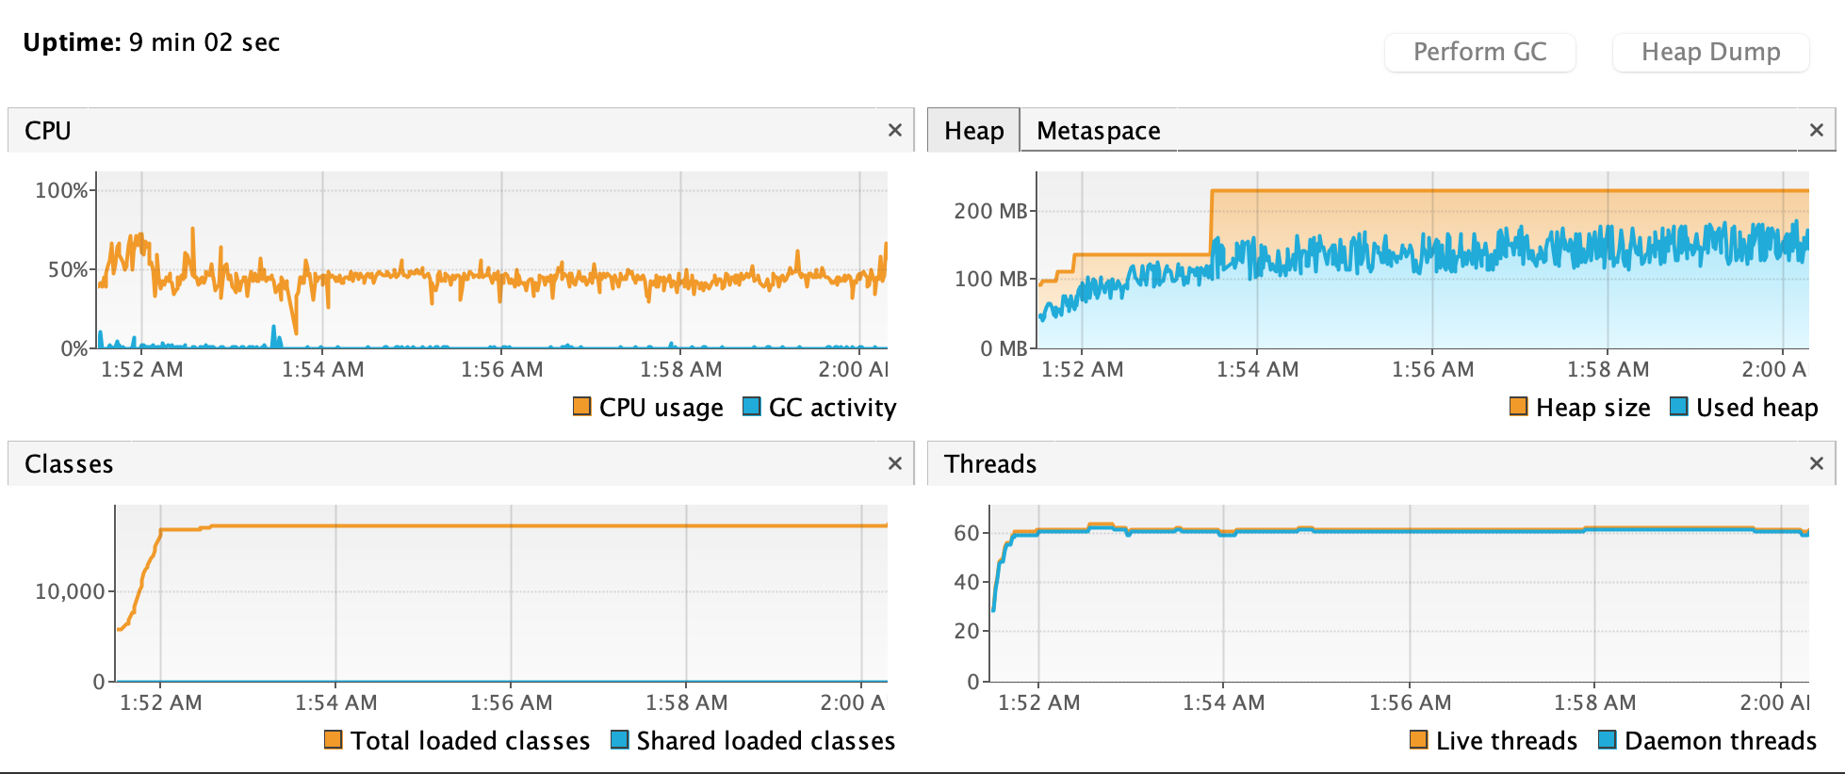
Spark test - dummy run

Slide 43
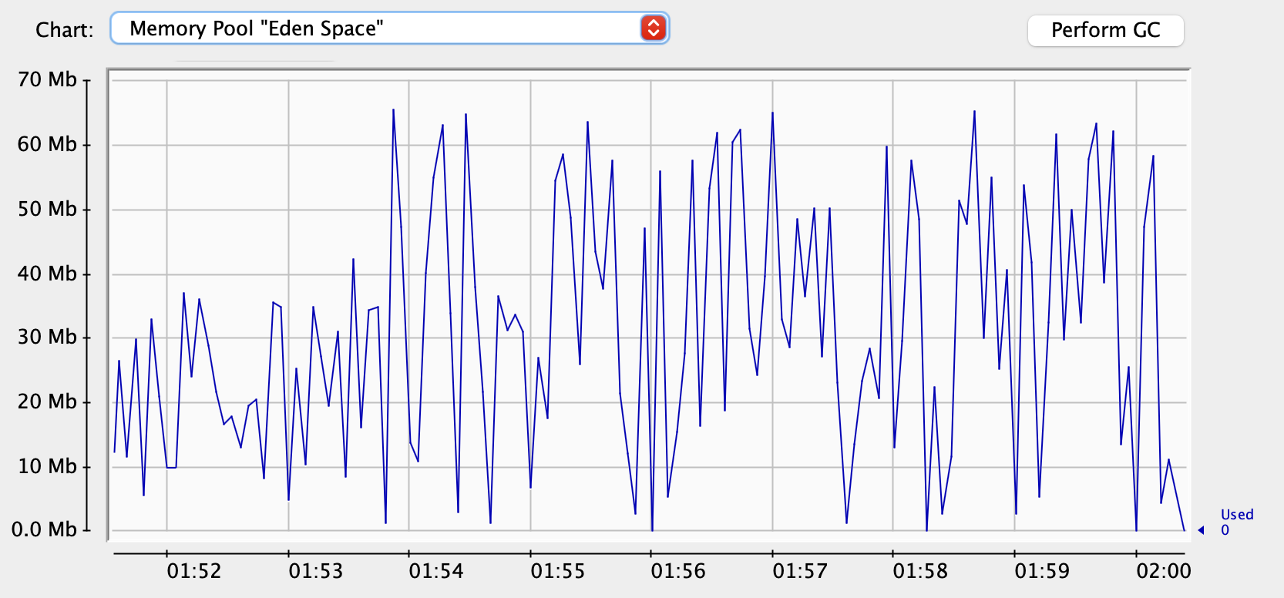
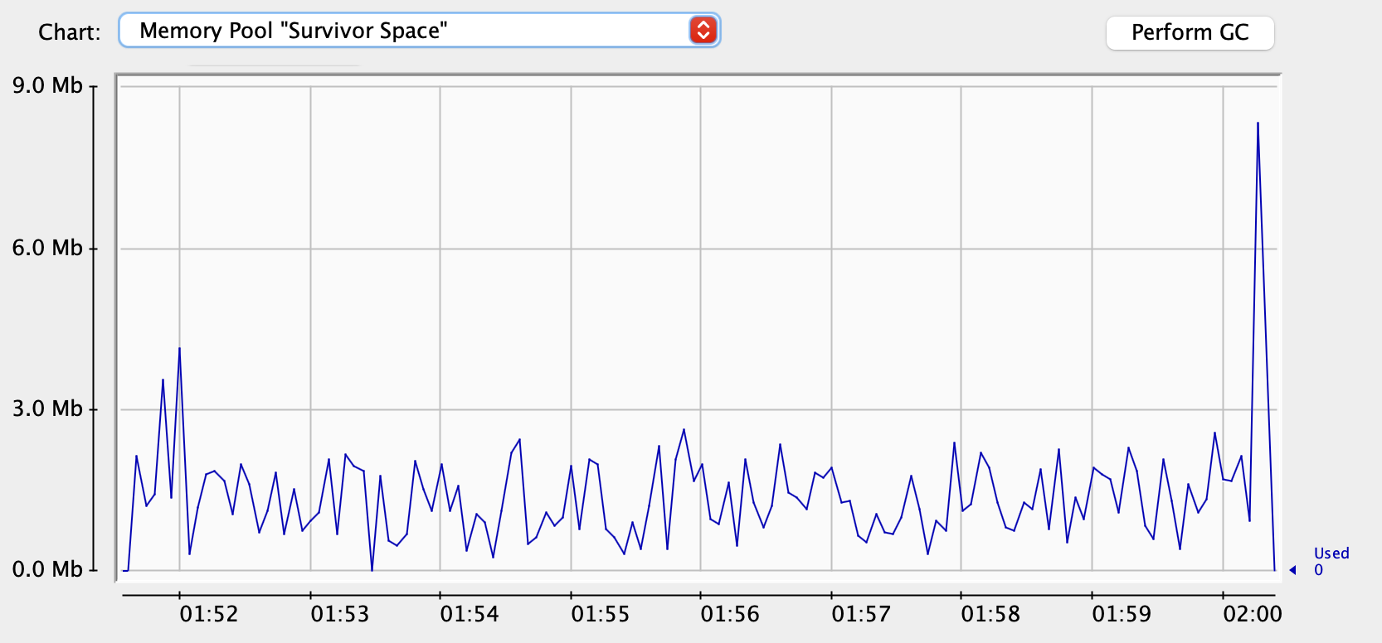
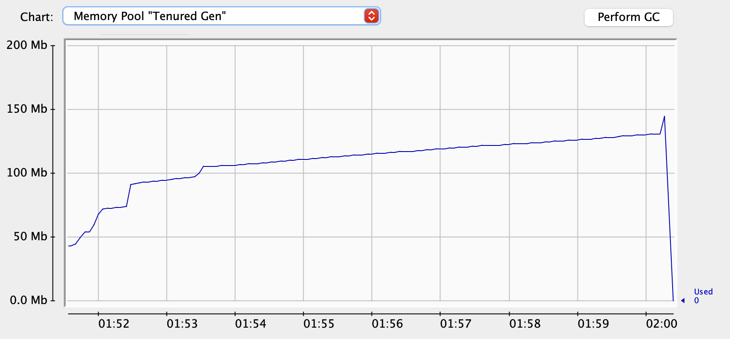
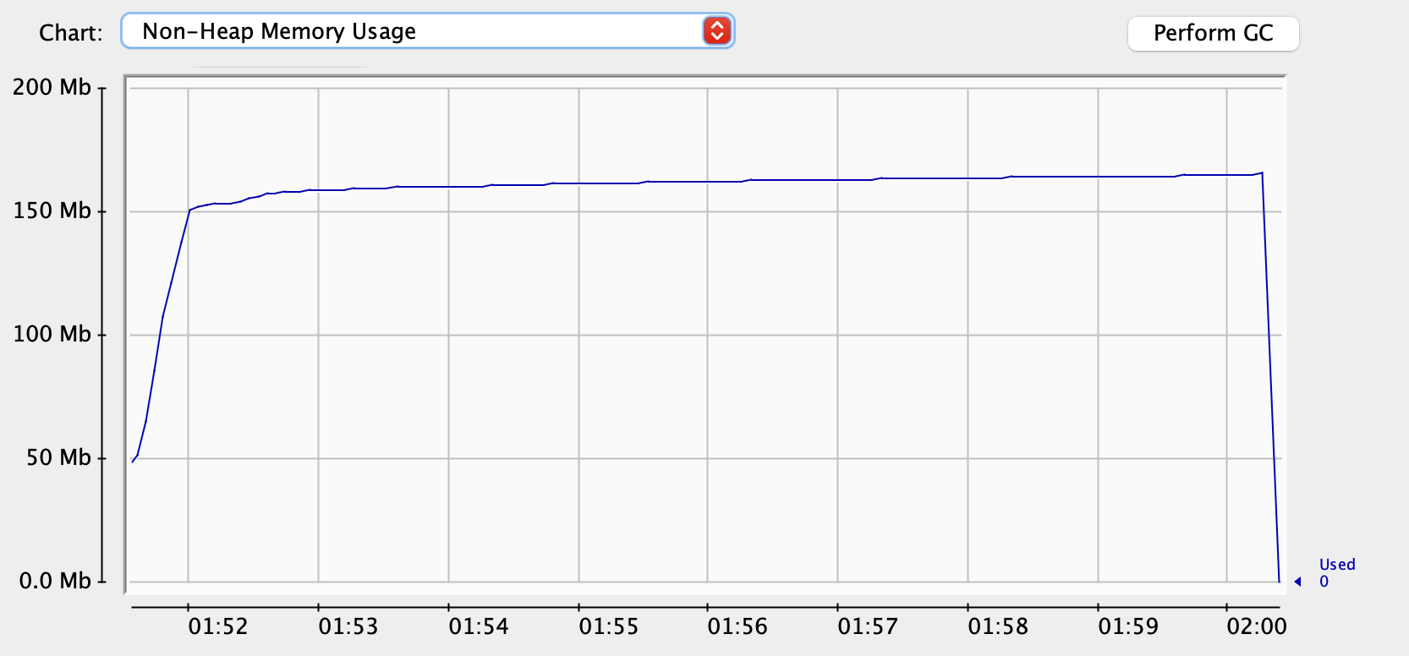
Spark test - dummy run

Slide 44
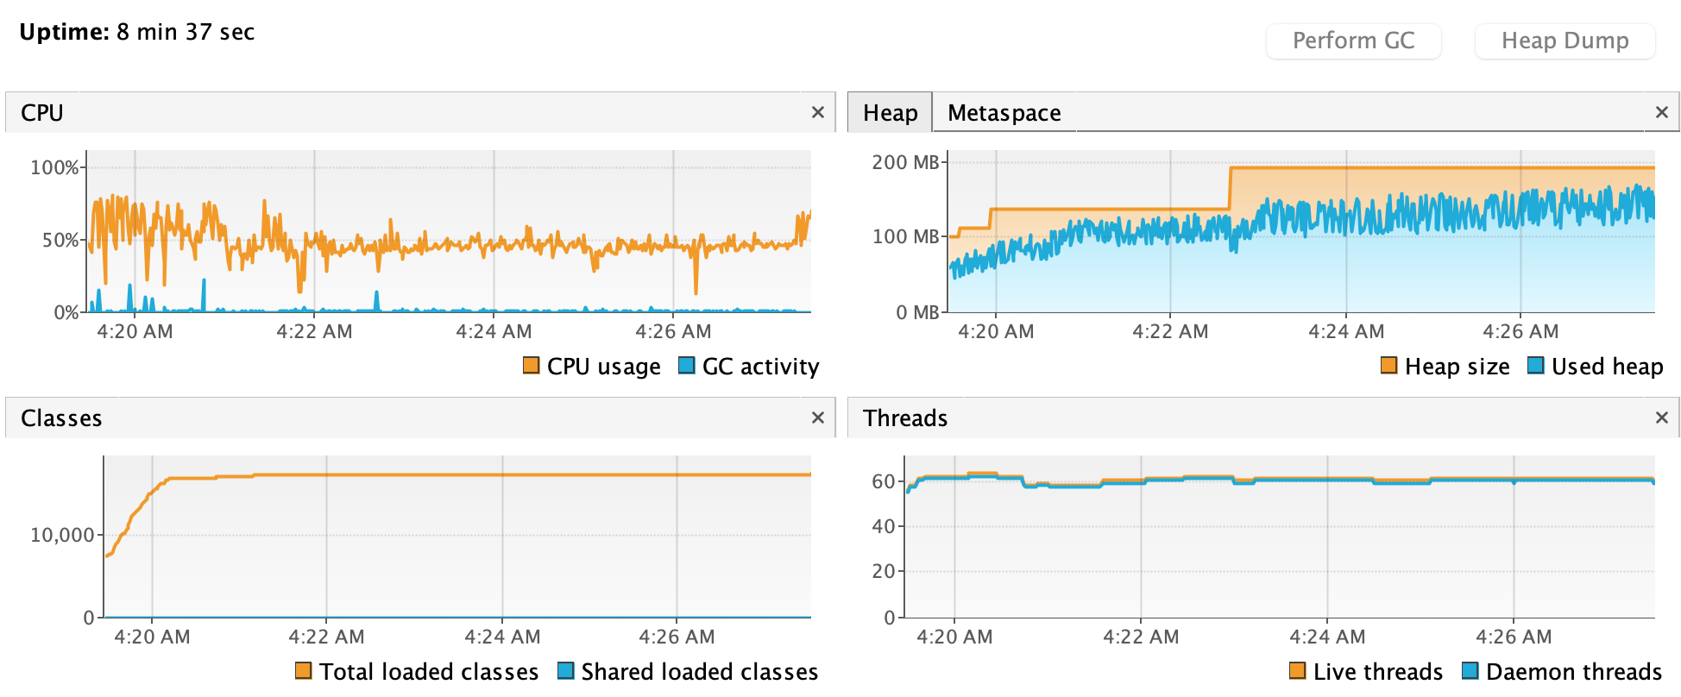
Spark test - optimized

Slide 45
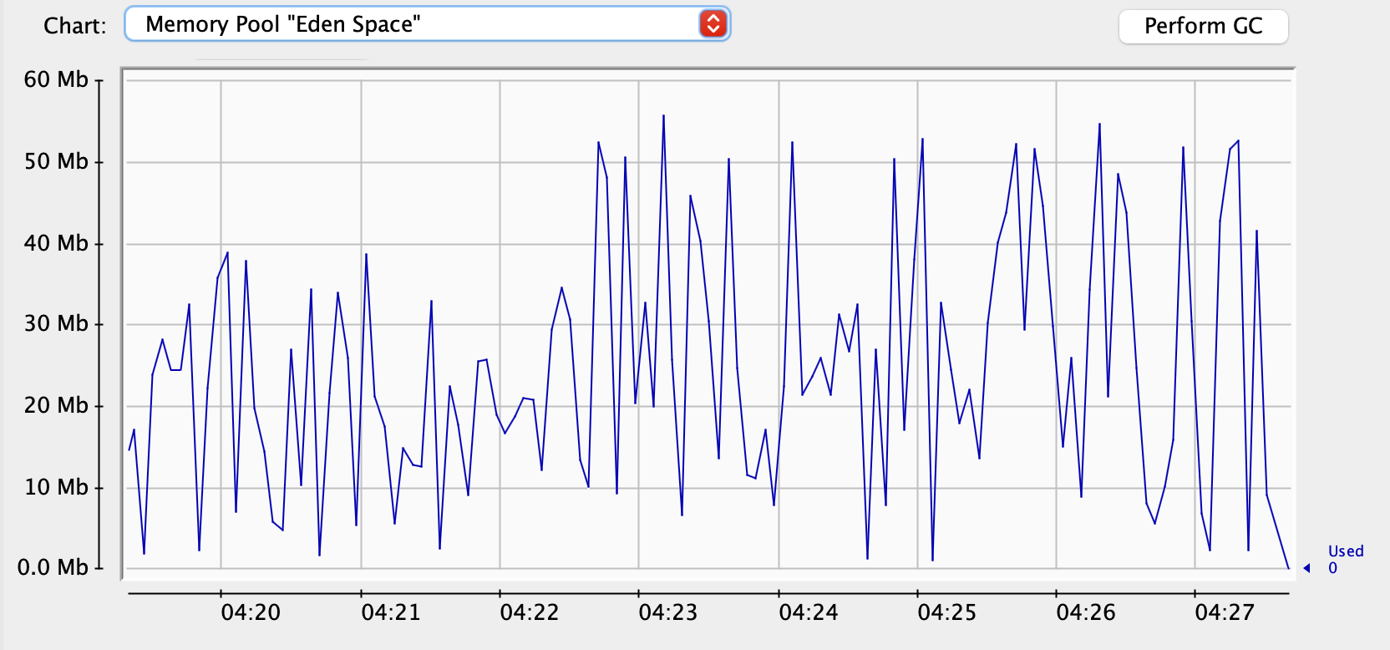
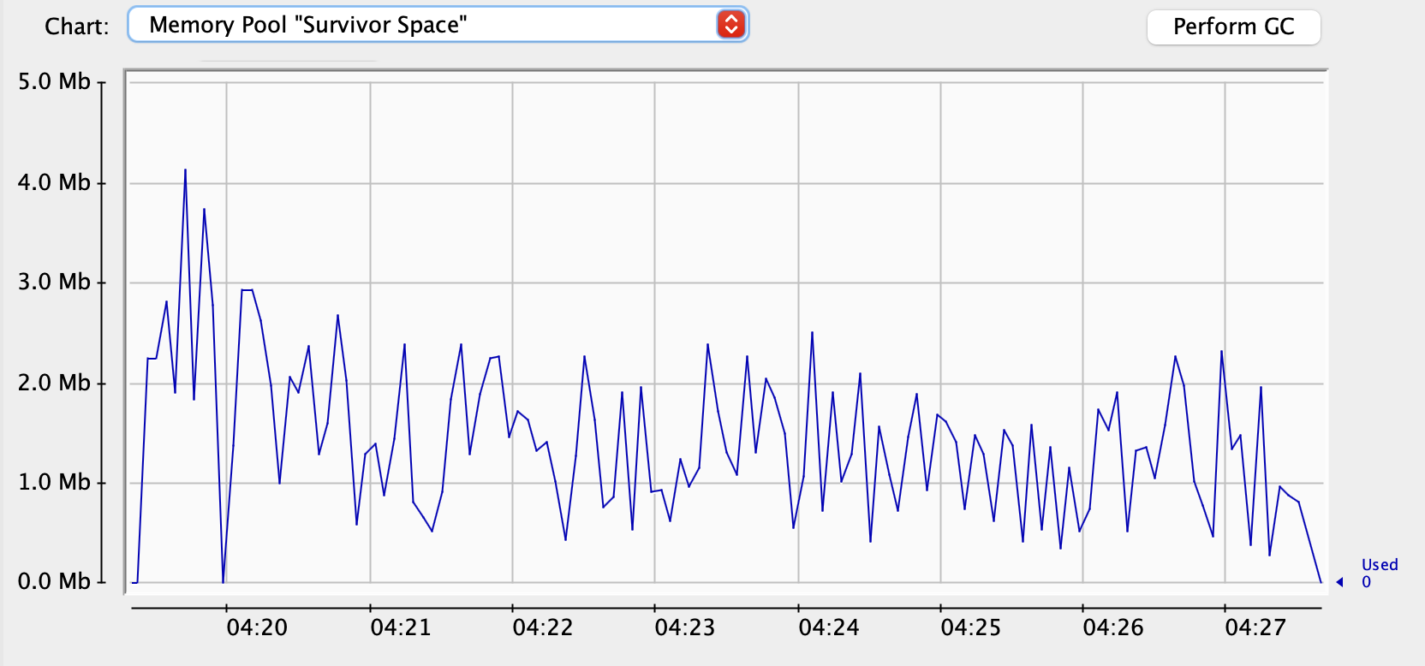
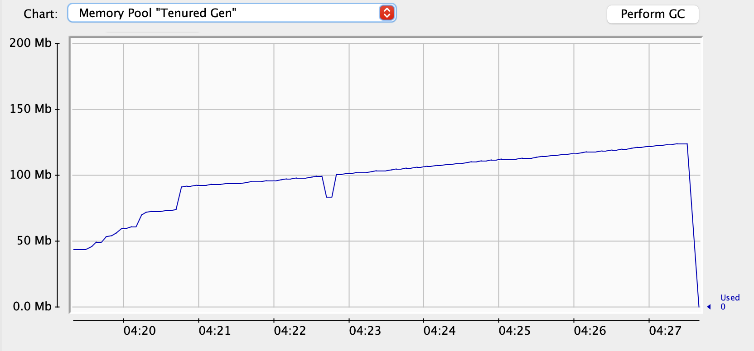
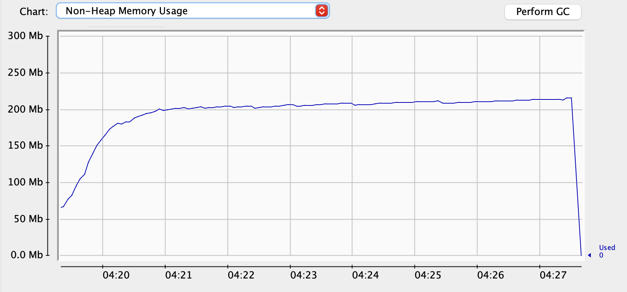
Spark test - optimized

Slide 46

Materials
Thanks for your attention
andrei_sadovkii@epam.com
https://github.com/minikill

